Slide 1

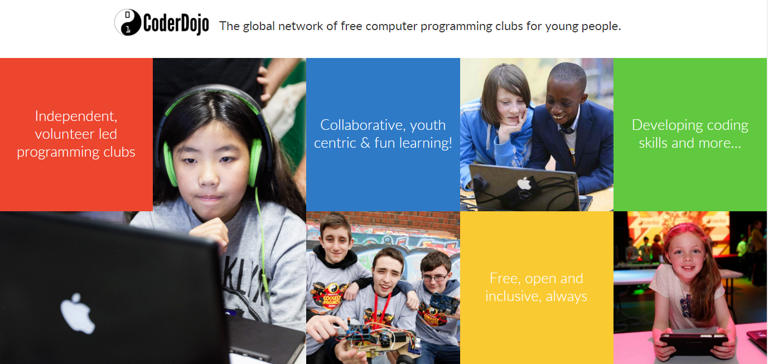

Slide 2
The CoderDojo movement believes that an understanding of programming languages is increasingly important in the modern world, that it’s both better and easier to learn these skills early, and that nobody should be denied the opportunity to do so.

Slide 3
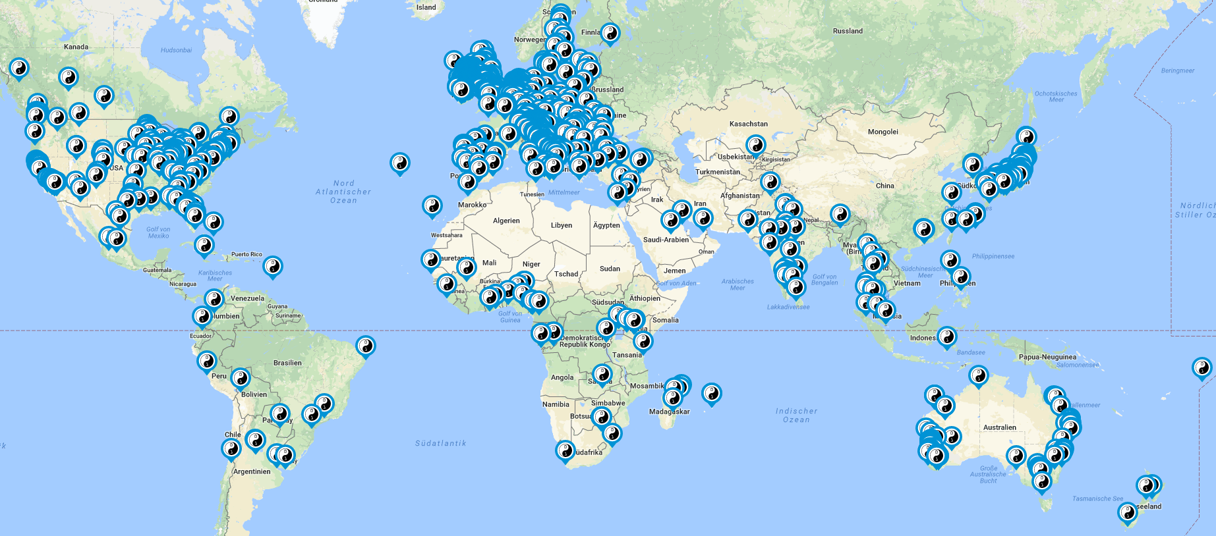

Slide 4
1100 CoderDojos
66 Countries
The CoderDojo Foundation was founded in 2011 by James Whelton and Bill Liao and the first CoderDojo started in July 2011 at the National Software Centre in Cork.

Slide 5
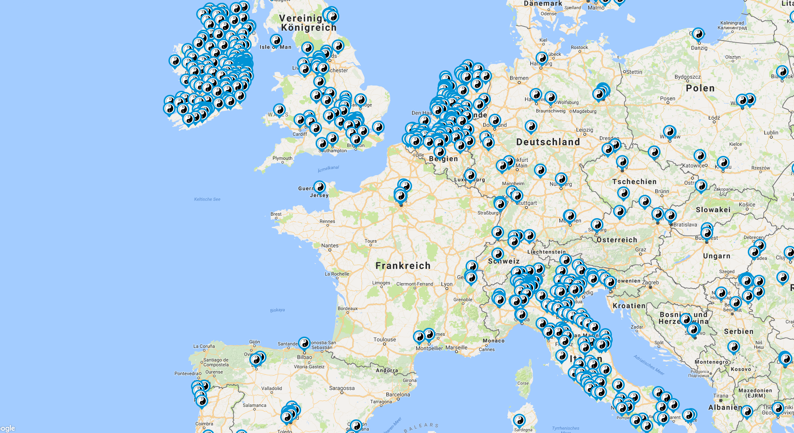
CoderDojo in Europe …

Slide 6
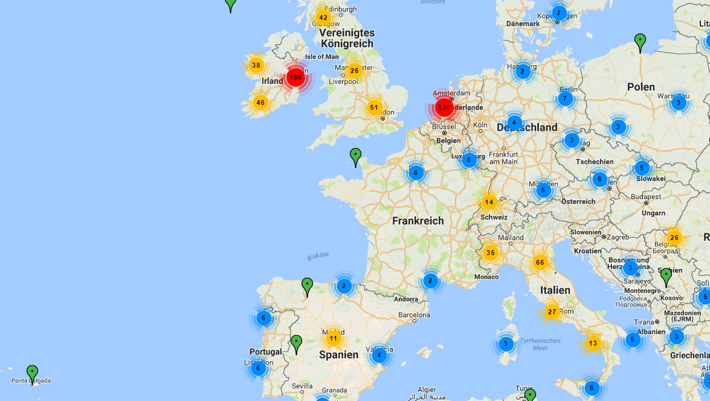
CoderDojo in Europe …

Slide 7
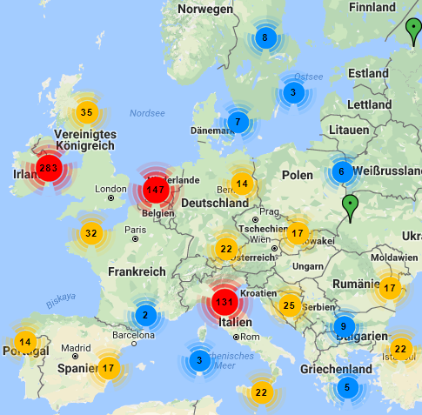
… and Germany?
CoderDojo in Europe …

Slide 8
Germany at the moment … 14 Dojos!
… and Germany?
CoderDojo in Europe …

Slide 9

Misson …
Development and support of new CoderDojos
Strengthening the community in Germany
Events around the topic „Children learn programming“
Aim: Every child in Germany should have the possibility to visit a CoderDojo!

Slide 10
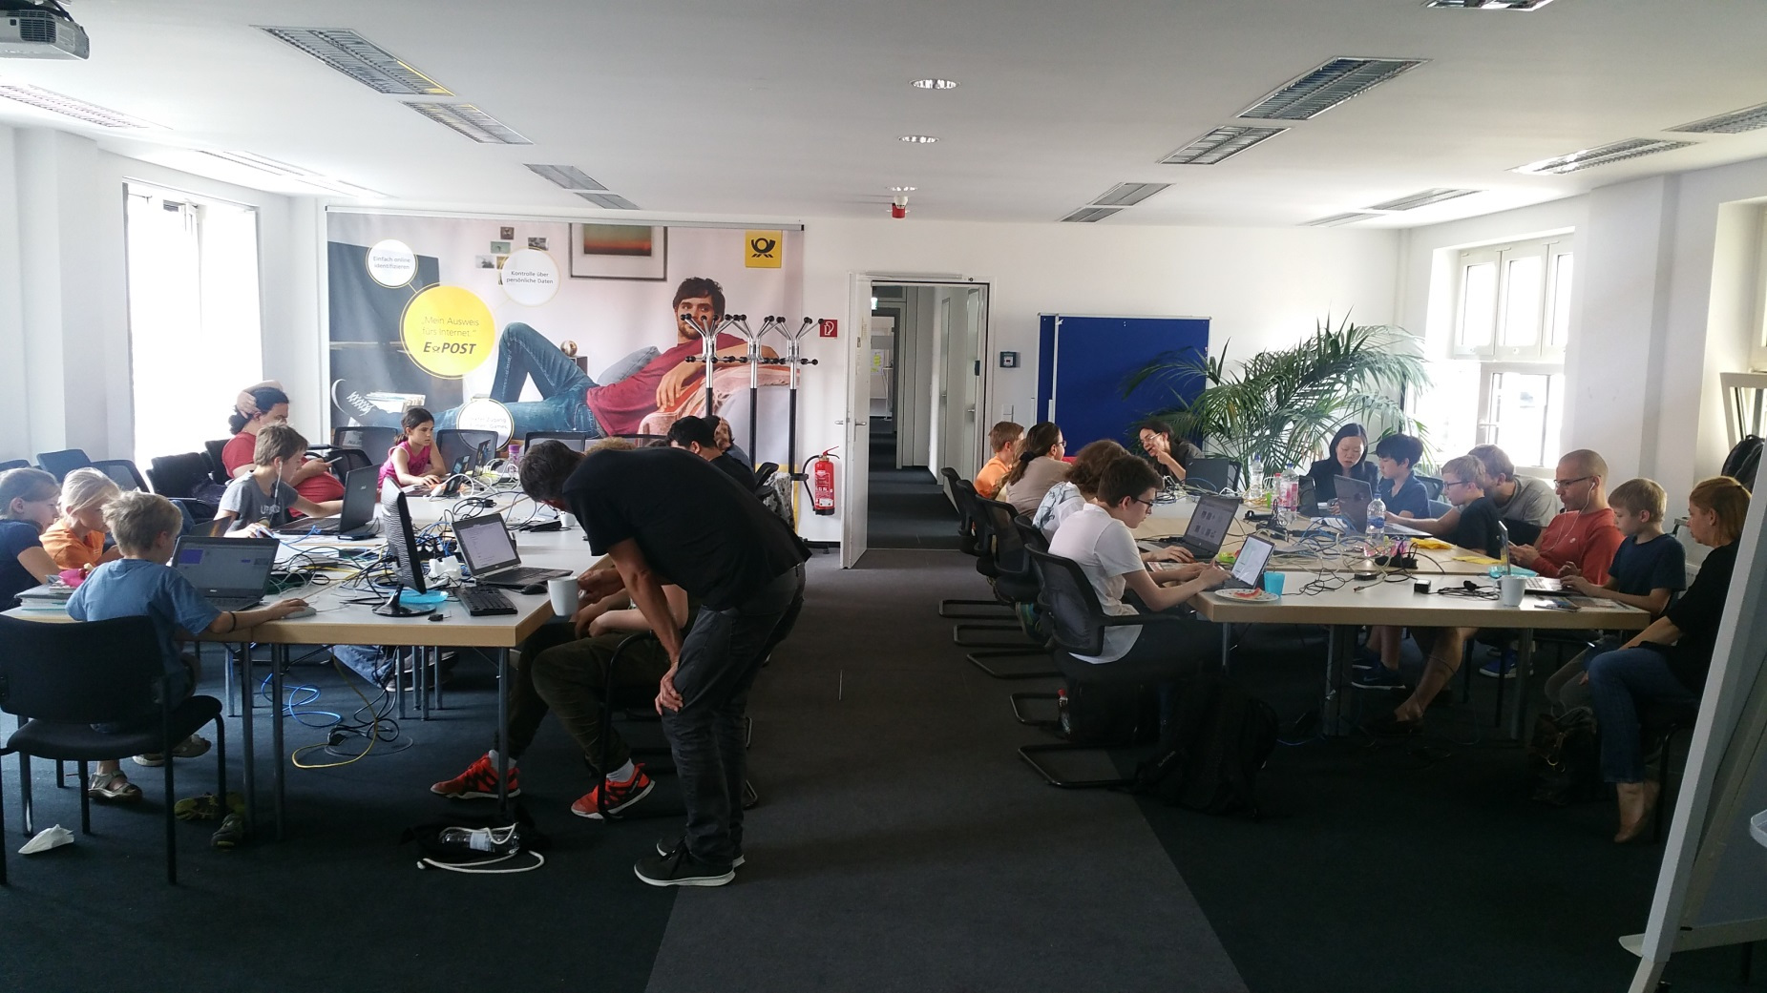

Slide 11
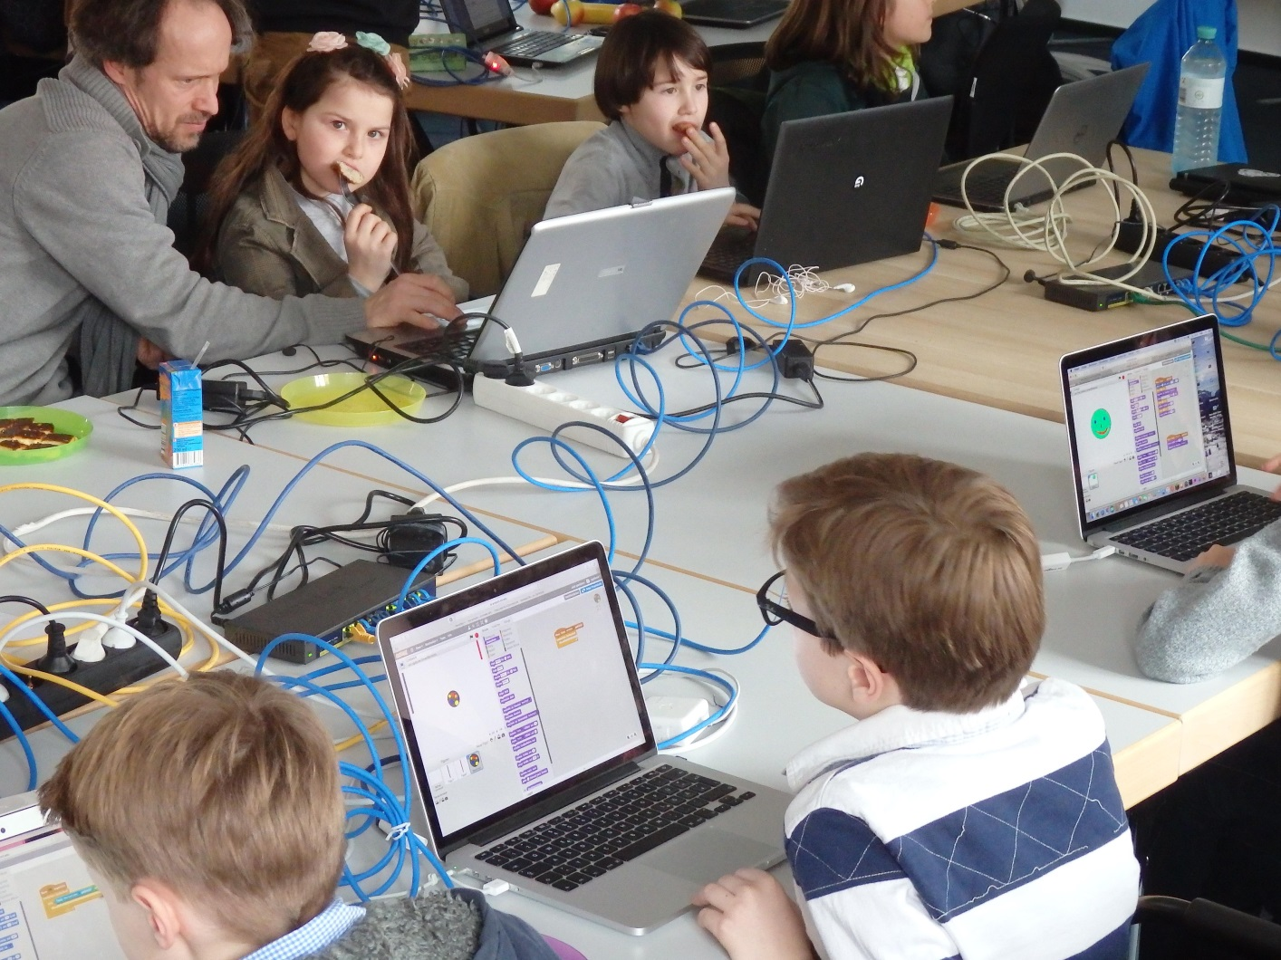

Slide 12
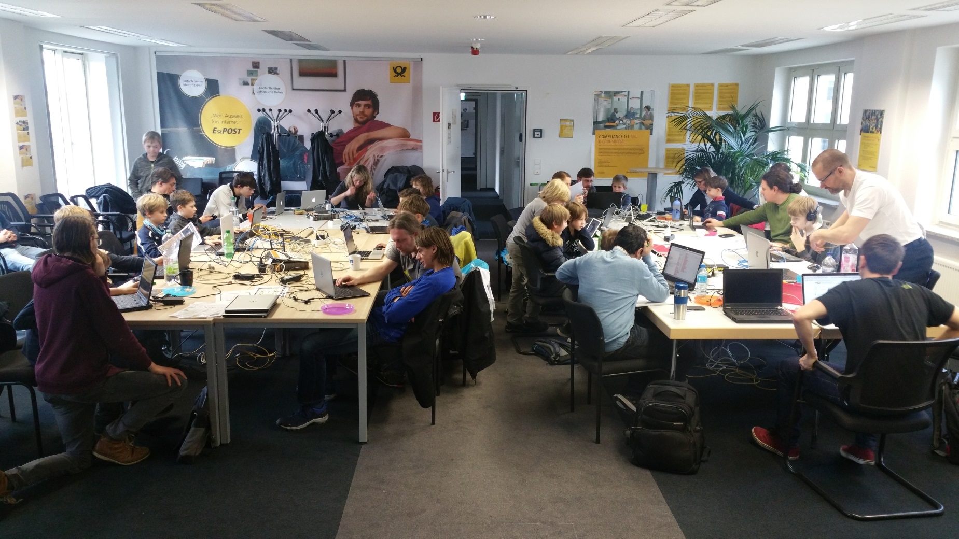

Slide 13
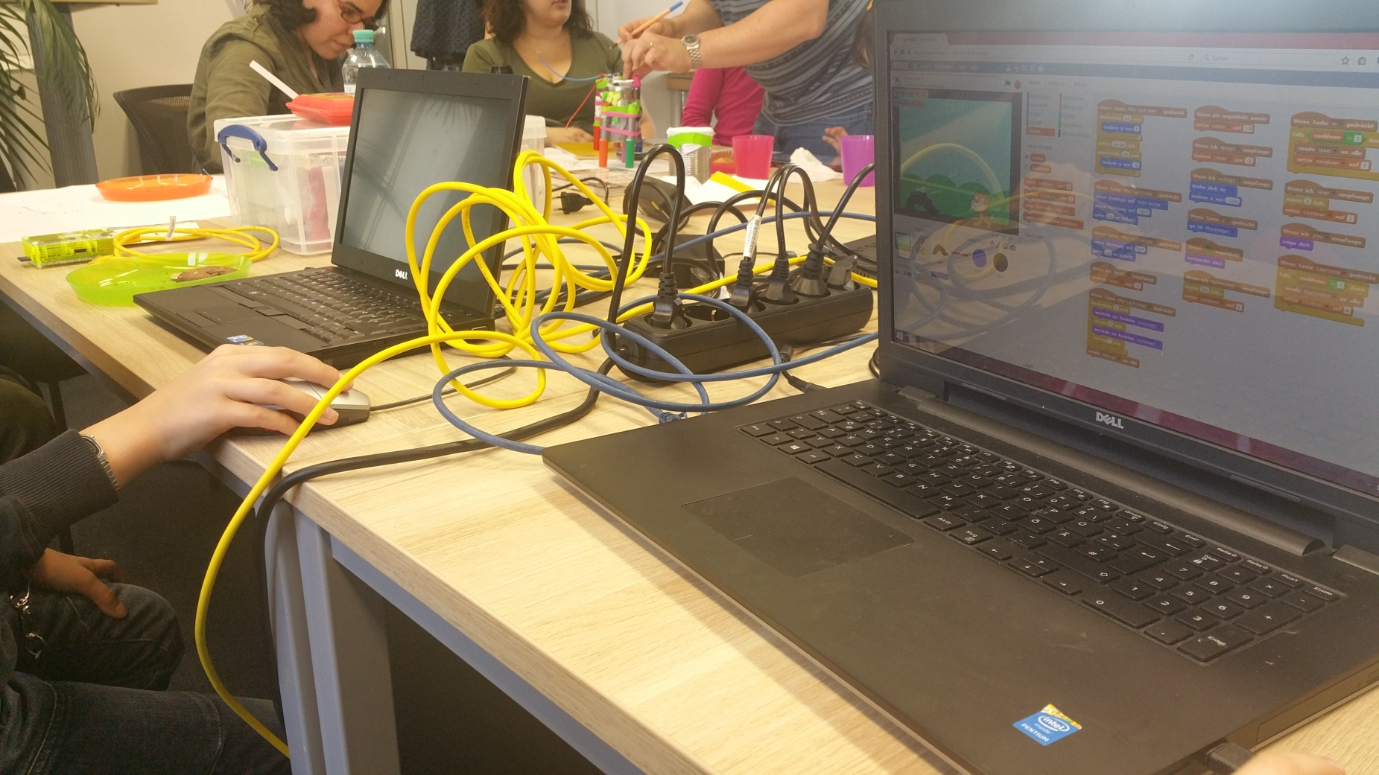

Slide 14
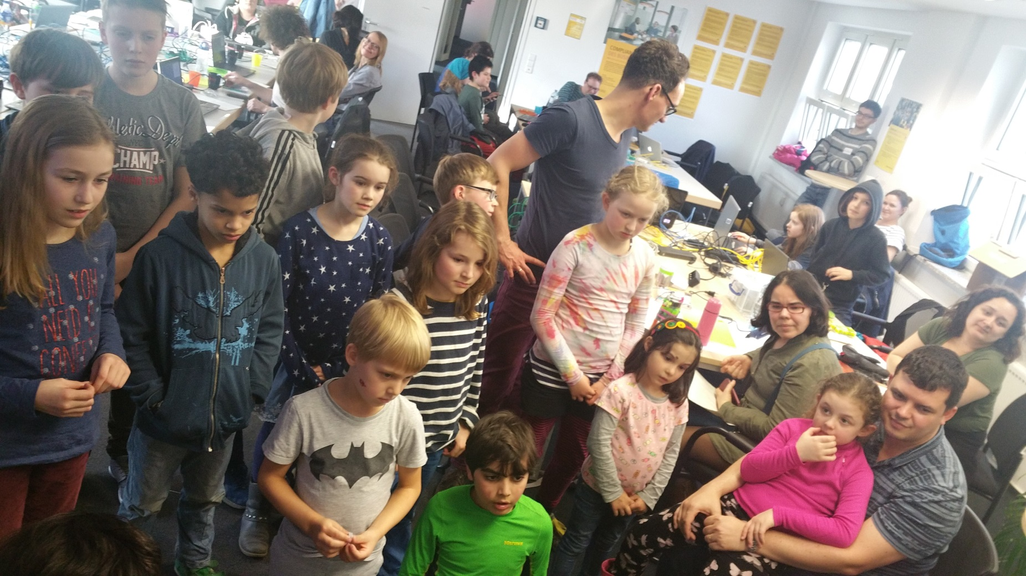

Slide 15
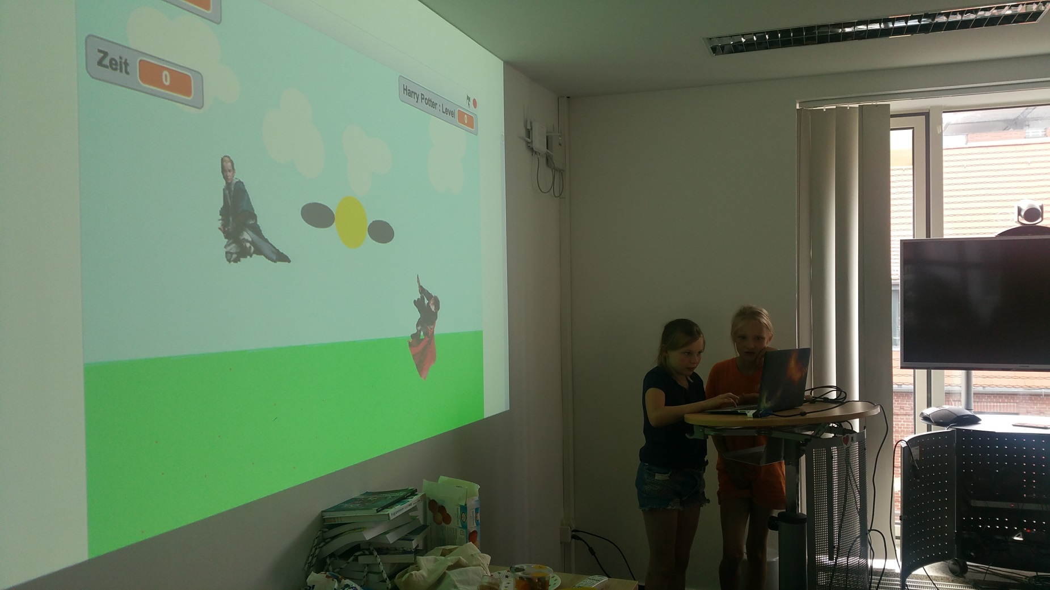

Slide 16
Method …
Tutorials for independent learning possibility
Mentors for helping with problems and projects
Mentor’s guideline from OpenTechSchool

Slide 17
Aims of a CoderDojo …
Individual growth and learning
Meeting other young people with same interests
Facilitating shared learning and exchange between participants
Create an atmosphere of possibilities and acknowledgement

Slide 18
Thank you for your attention...
Questions?
www.coderdojo-deutschland.de
Contact:
nicco@coderdojo-deutschland.de
karsten@coderdojo-deutschland.de

